Slide 1
Code Review for DevOps
FOSSASIA 2016
Saturday, 19 March 2016
Elizabeth K. Joseph
Hewlett Packard Enterprise
lyz@princessleia.com
@pleia2

Slide 2
Elizabeth K. Joseph
OpenStack Infrastructure Team DevOps Engineer, paid by Hewlett Packard Enterprise
Long time contributor to various open source projects
Co-author of The Official Ubuntu Book, 8th ed

Slide 3
OpenStack Infrastructure Team
Our job is to make sure the OpenStack developers can do their job
All of our system configurations are open source and tracked in git: https://git.openstack.org/cgit/openstack-infra
Anyone in the world can propose patches for direct inclusion in our infrastructure, instructions at: http://docs.openstack.org/infra/manual/developers.html
We all work remotely, worldwide.

Slide 4
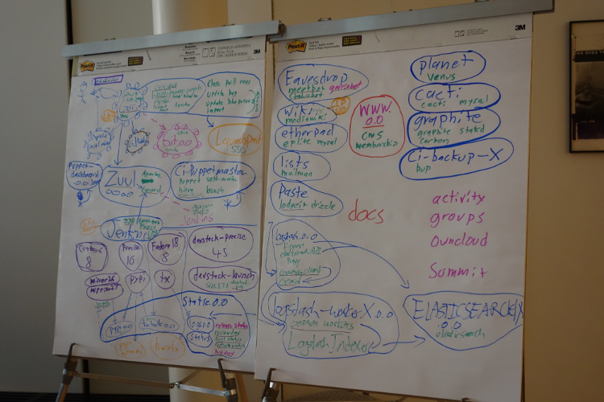
We run services for developers
Askbot
Continuous Integration systems
Cacti
Elasticsearch, Logstash and Kibana
IRC Bots
Etherpad
Git
Paste
Planet
Puppetboard
Mailing Lists
Translations platform
Various web services
Wiki

Slide 5
OpenStack Continuous Integration (CI) System
Lots of individual projects (1000+)
All projects must work together
Changes can't break master branch
Code should be syntactically clean
Testing must be completed automated

Slide 6
Tools we're using for CI
Launchpad (someday: openstackid)
Git
Gerrit
Zuul*
Gearman
Jenkins (with jenkins-job-builder*, devstack-gate*)
Nodepool*
* Started by the OpenStack Infrastructure team

Slide 7
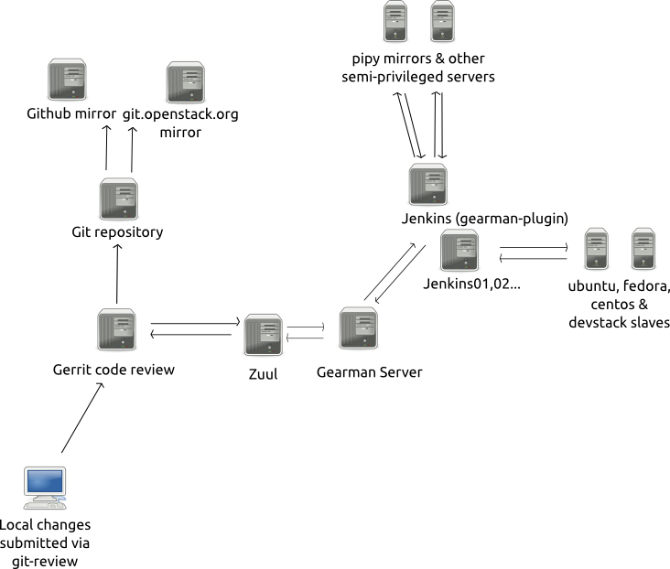
Workflow

Slide 8
Why do I care?
The Infrastructure team uses it too!

Slide 9
Automated tests for infrastructure
flake8 (pep 8 and pyflakes)
puppet parser validate
puppet lint
Puppet application tests
XML checkers
Alphabetized files
IRC channel permissions

Slide 10
Peer review
Multiple eyes on changes prior to merging
Good infrastructure for developing new solutions
No special process to go through for commit access
Trains us to be collaborative by default
Anyone can contribute, anyone can devote resources to it

Slide 11
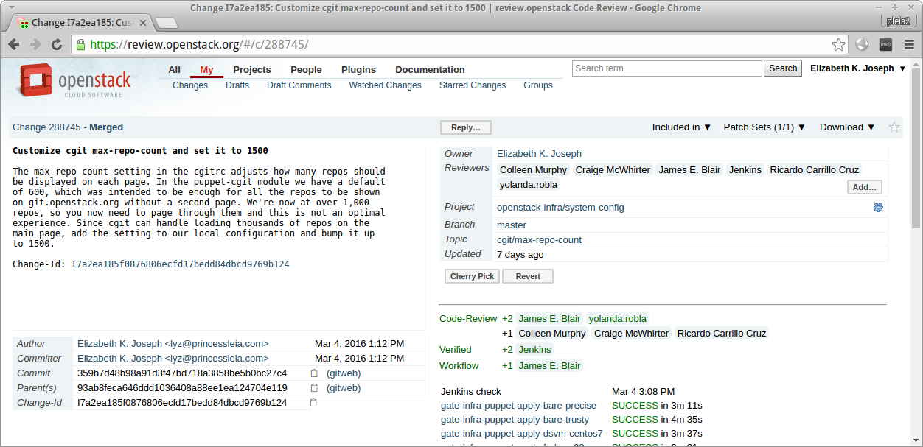
Gerrit 1/2
https://review.openstack.org/#/c/288745/

Slide 12
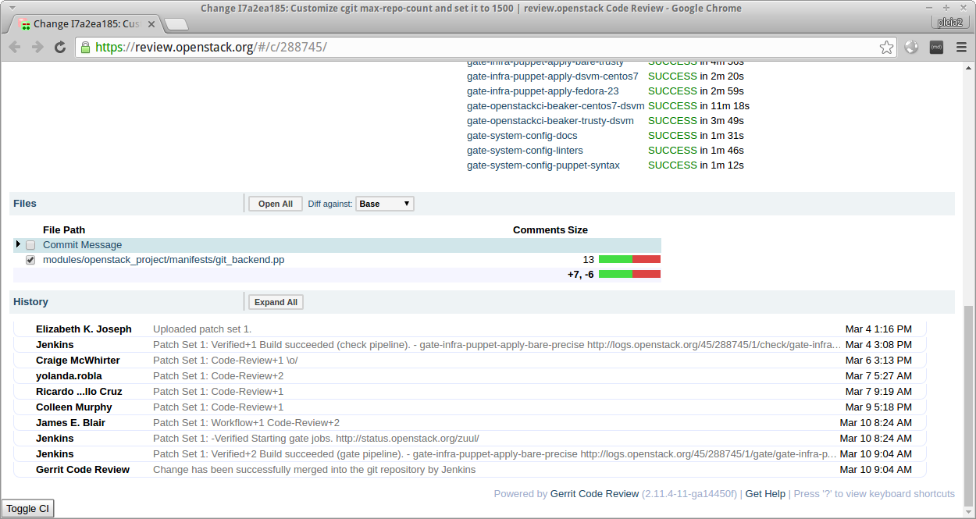
Gerrit 2/2

Slide 13
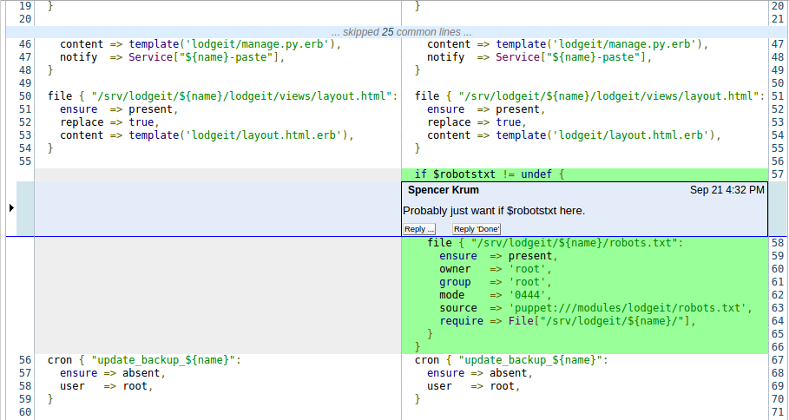
Gerrit in-line comments

Slide 14
Automated deployment
Change gets approved, tested and merged
...Either puppet master gets updated and applies change
...Or continuously deploy via the vcsrepo module in Puppet pulls in latest version of project

Slide 15
Can you really manage an infrastructure via git commits?
Cacti (http://cacti.openstack.org/) to keep an eye on server usage

Slide 16
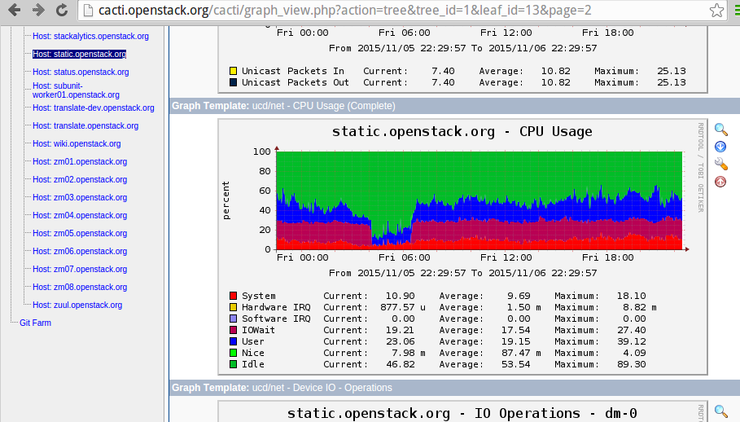
Cacti

Slide 17
Can you really manage an infrastructure via git commits? (2/3)
PuppetBoard (http://puppetboard.openstack.org/) so you can watch your changes get applied, or not

Slide 18
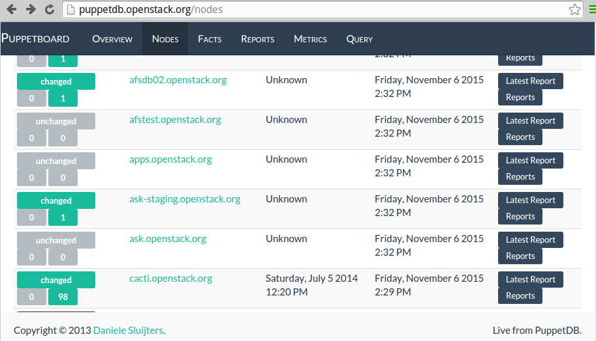
PuppetBoard

Slide 19
Can you really manage an infrastructure via git commits? (3/3)
Thorough, specific documentation at http://docs.openstack.org/infra/system-config

Slide 20
Well, not everything
Automation is not perfect, sometimes you just need to log into a server
Complicated migrations and upgrades need manual components (but we automate more every time!)
Initial persistent server deployment still has manual components
Passwords need to be privately managed (but we use git!)

Slide 21
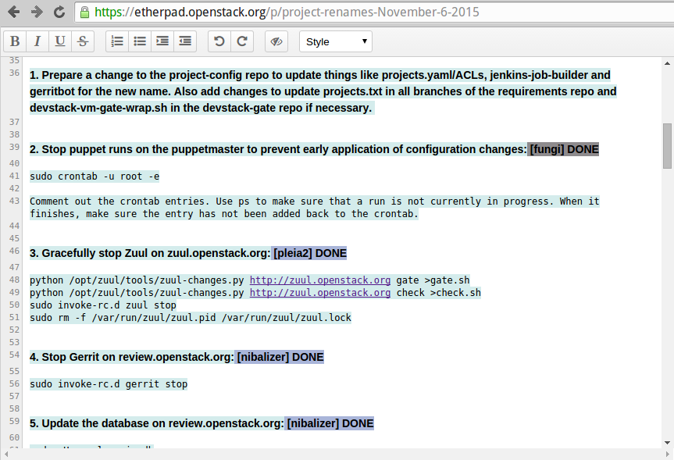
Maintenance collaboration on Etherpad

Slide 22
Human collaboration
Main IRC channel (#openstack-infra)
Incident IRC channel (#openstack-infra-incident)
Sprint IRC channel (#openstack-sprint)
Weekly IRC-based meetings (#openstack-meeting)
Channel/Meeting logs on http://eavesdrop.openstack.org/
Pastebin http://paste.openstack.org/
In person collaboration at the OpenStack Design Summit every 6 months
No voice or video calls.

Slide 23
And then there are time zones :(
Increased coverage is great, but...
  The first core/root member in a particular region struggles to feel cohesion with the team
  Increased reluctance to land changes into production
  Makes for slower on-boarding for key tasks
Only solved by increasing coverage in that time zone so they're not alone

Slide 24
But mostly it's pretty great!
(and our team always needs help)

Slide 25
Questions
The email address I use: lyz@princessleia.com
HPE email: lyz@hpe.com
Freenode: pleia2
OpenStack CI Resources: http://docs.openstack.org/infra/system-config/

